Slide 1
QF621 Quant Trading Strategies
Team:
ER HWA MING 01477223
JOHANN FONG CHEOK ARN 01294185
LIM WEN KAI JONATHAN 01484523
OW WAI TING 01332586
SIM SHAN QIN 01329428

Slide 2
Investment objectives
We identify a mean reversion framework for stock picking across the Japan equity markets
Our goal is to construct a market neutral - low net portfolio
We believe we will be able to deliver high risk adjusted returns, in a strategy that is scalable given the depth and breadth of the Japanese market.

Slide 3
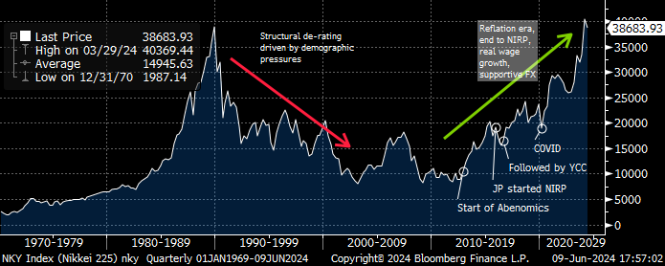
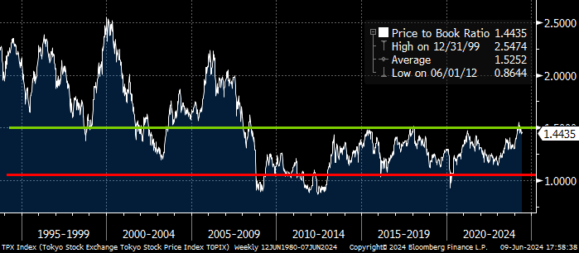
Why Japan? and why now?
The Japan market has typically been a mean reverting market given its aging population demographic dynamics. Post-covid, that view has changed, with market participants believing that the re-emergence of inflation has the power to drive sustained real wage growth. This is supported by a move back to positive interest rates and meaningful corporate governance changes.
Be that as it may, with the Nikkei surpassing its 1989 peak, we believe that the structural re-rating of Japanese markets has played out largely, and from hereon we are likely to swing back to its mean reverting nature. With that view, we look to develop a mean reversion framework.

Slide 4
#1: Data gathering
Defining the universe
Japan: We focus on Japan and narrow our view to the Topix, comprising of 2144 constituents.
The Topix accounts for ~90% of the market, outside of which we believe that liquidity and free float will be a constraint to the execution of our strategy.
Data gathering
Daily price:
10 -year daily price history of the Topix constituents
Possible inclusion of stocks that have been removed from the current index
Price should be adjusted for stock splits and other related actions
GICs classification to cluster stocks
Stock market cap
Daily ADV

Slide 5
#2: Valid pair testing
Identifying possible combination of pair
Based of our universe of the TOPIX index, consisting of 2144 constituents, we were able to map out 63K possible combination of pairs
Liquidity considerations
In order to increase the scalability of pairs and also manage for slippage, we set an ADV limit of US$10mn
Test for stationarity
We apply the ADF test to test for stationarity.
Our output yields 3.8K pairs, relevant for trading

Slide 6
#3: Mean reversion framework
Entry
For the valid pairs, trade entry point is triggered when spread is at the 1 st dev point
We calculate the 1 year rolling mean, 1 and 2 st dev spread band to set the criteria
Profit taking
Trade exit / profit take is triggered when spread reverse back to mean
Stop loss
Trade is cut / stop loss gets triggered when spread is at the 2 st dev point

Slide 7
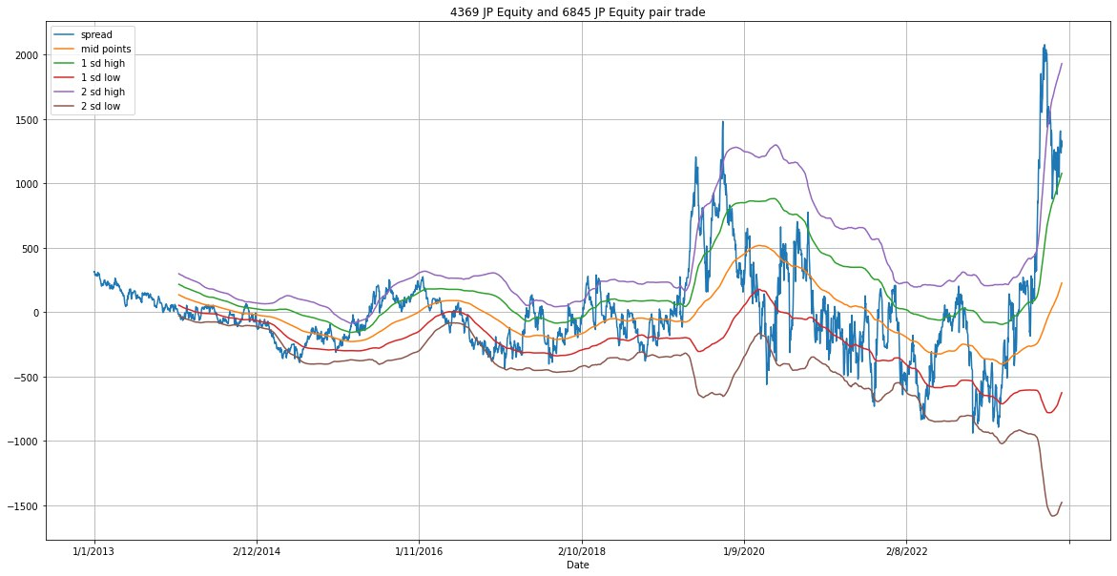
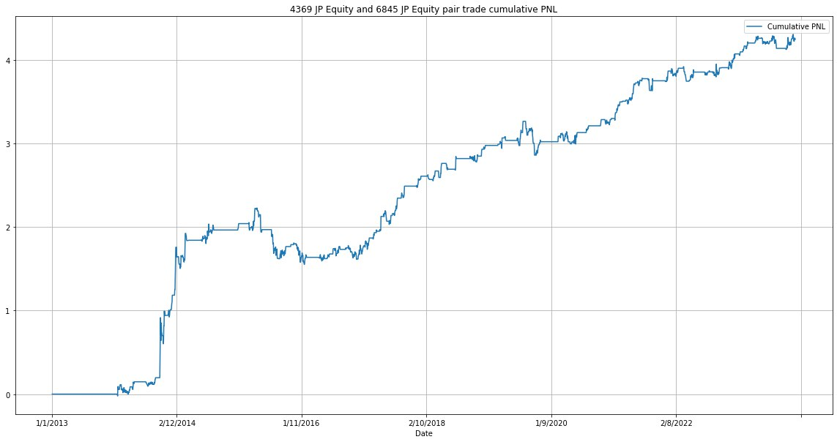
#4 Backtesting the strategy: Standalone pairs
Tracking the spread progression through a 10.5 year look back
Strategy generally yields a positive PnL with small pockets of draw down
Key stats of the pair 4369 JT vs 6845 JT

Slide 8
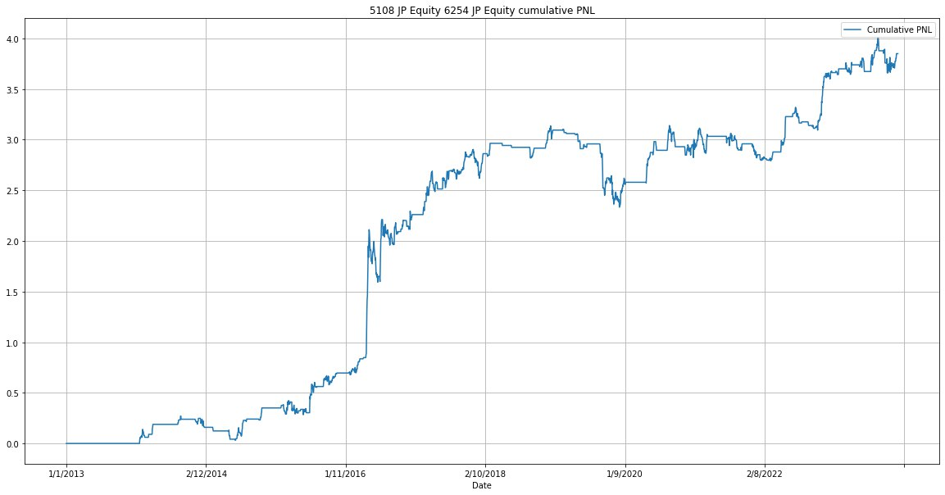
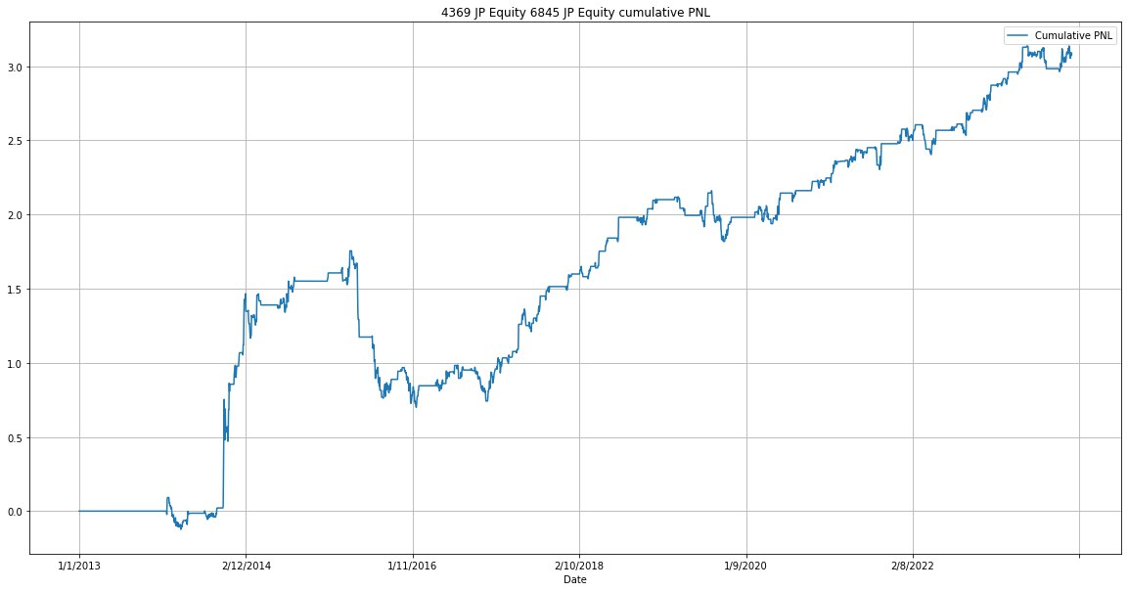
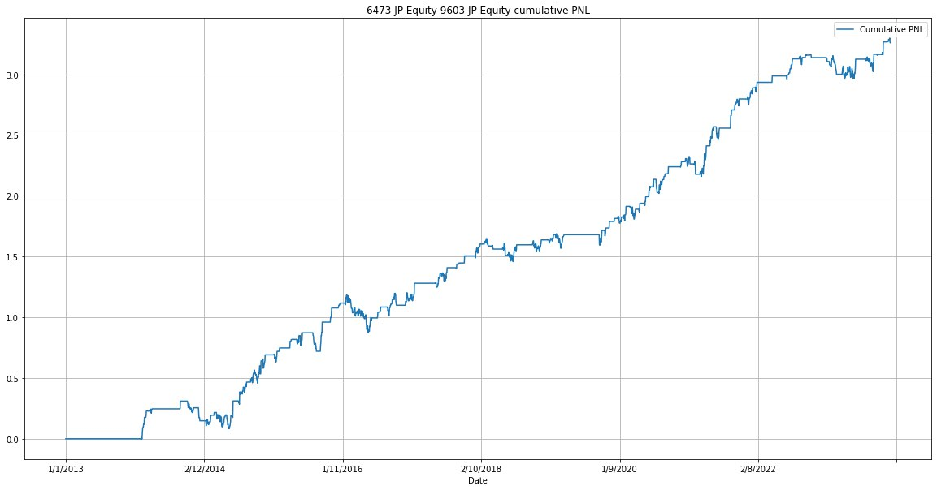
#5 Portfolio construct: best pair search
We keep criteria at Cumulative PnL of > 1.5. This means a 10 year PnL of 1.5mn over a strategy that runs 2mn GMV for each trade
We construct our forward-looking portfolio based on trading pairs that have exhibited the best 10 year return profile on our preset mean reversion criteria.
Is this hindsight/survivorship bias? Possibly, but each pair being able to general a high watermark PnL is 1.5mn speaks of the quality of the pair over a long enough back tested horizon
379 pairs is a diverse set: we believe 379 pairs provides enough diversification to support the statistical significance
Cumulative PnL > 3. Pairs: 9
Cumulative PnL > 2. Pairs: 107
Cumulative PnL > 1.5. Pairs: 379
Cumulative PnL > 1. Pairs: 1081

Slide 9
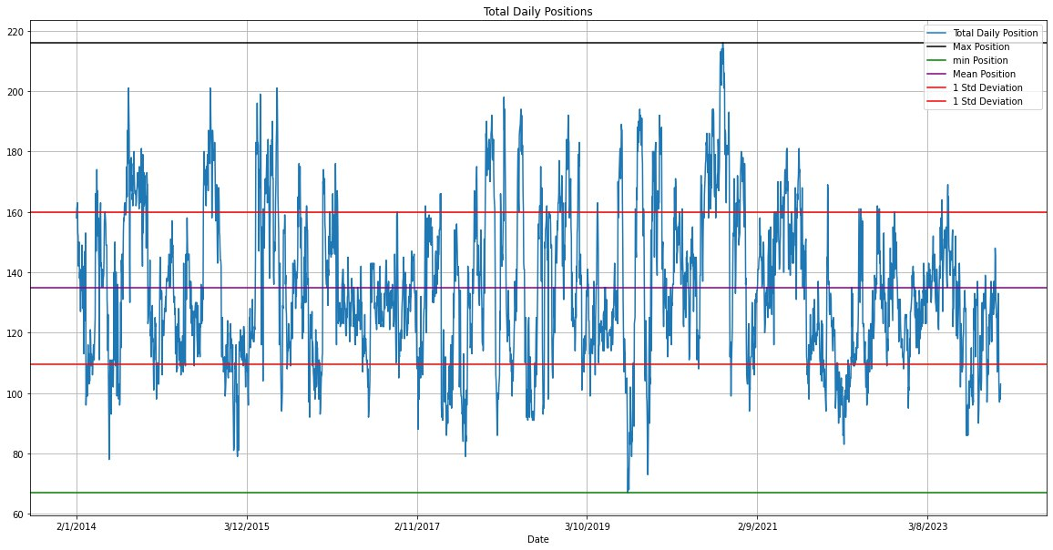
#6 GMV: Scaling dynamically depending on signals
For now, we have decided not to target a specific GMV, however in subsequent improvements we could be looking into GMV normalization
GMV stands on average at around 270mn assuming both legs of trade, but at peak can be around 450mn. This is on the assumption that each position has a US$1mn notional size
Given that we only trade pairs, NMV is 0
At the current juncture, we do not assume any rebalance of drifting rations between pairs, and could be a source of NMV divergence from 0

Slide 10
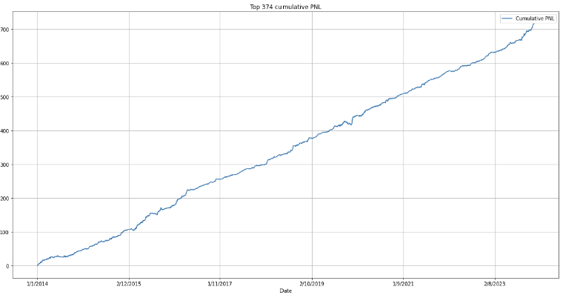
#7 Cumulative return:
Consistent upwards drive in return,
We see small pockets of drawdowns, but period seems to be short lived
Concentration risks: We allow for same securities to be traded on multiple legs of discrete pairs. For now the highest concentration a 33 / 379 pairs. Which is MSD % of GMV. We are generally comfortable with maintaining at this level.
But in our forward strategy could introduce caps.

Slide 11
#8 Trading cost: what are the implications
For now,

Slide 12
#9 Sharpe: what are the implications
For now,

Slide 13
#10: Considerations as we progress
• Setting how the book exits older ideas and adds newer ideas – average holding period
• Number of positions – Deliberate whether to stick to fixed number of positioned (~100 positions) or give flexibility to scale up based on signals
o Decision parameters on ideas to exit when new signals come through
o Positions sizing especially if we do give flexibility on number of positions
• Scalability of the strategy — whether strategy can be scaled from US$100mn to US$1bn
o How to scale - more positions, or larger size – liquidity constraints and market impact studies key
• Sizing variation – stick to equal weighting or look to size up based on certain signals
• Trading Turnover targets – initial start point 10-20% of GMV a day
o Book turns 20% * 250 trading days – to assess associated trading cost implication
• Entry point – Closing price or VWAP based on back test

